Slide 1
Complete POP Template Cover Page (for ALL funds)
Program |  |  |  | Activity Details
 |  | AMD |  | Activity Name | FY20Q4_ECOSYSTEM_ROADSHOW_CITY2_INCR_STORAGE
 |  | McAfee
x |  | IIP |  | Allocadia ID | 327060 |  | Start Date | 12 | 05 | 2019
 |  | IIF |  | DellShare ID | 2446041 |  | End Date | 12 | 05 | 2019
 |  | MSFT Discretionary |  | Country(ies) | Goiania
 |  | MSFT Performance |  | Activity type | Event
 |  |  |  | Activity Cost | 7,500.00 | (in USD)
Summary
V 2.0 – June 2019

Slide 2

Supporting Documentation
Status | Nome | Empresa
Presente | Alvaro Gouveia Jr | Grupo TecnoSeg
Presente | Arthur Guilarducci | Integratto Tecnologia
Presente | Diego Peixoto | CORP CENTER TECNOLOGIA
Presente | Dinailton José da Silva | PUC Goiás
Presente | DIOGO PEIXOTO DE MOURA | CORP CENTER TECNOLOGIA
Presente | Diogo Ramos | Tecnoseg
Presente | EURIPEDES ANDRADE | GENIUS CONSULTORIA
Presente | Fernando Gonçalves da Silva Linos | Hospital Anis Rassi
Presente | Gamaliel Rodrigues da Luz | HalexIstar
Presente | Lincoln Brito de Lima | Universidade Federal de Goiás
Presente | Manuel Burlamaqui | Grupo Toctao
Presente | Marcelo Lopes de Souza | Novo Mundo Móveis e Utilidades
Presente | Marcos Antonio P. Sousa | Secretaria de Economia
Presente | Natan Mendonça Nogueira | SEMAD
Presente | Paulo Bueno | Casa do Pica-Pau
Presente | Paulo Vitor F. da S. Cabral | HalexIstar
Presente | Pedro Braga | Infomach Soluções
Presente | Rafael Barbosa | Halex Istar
Presente | ROGERIO OLIVEIRA | INTEGRATTO
Presente | Spartakus E. M. Pimenta | Novo Mundo
Presente | Taciano Rossi | Loft Construtora
Presente | Thiago Vieira de Sousa | Infomach Tecnologia para Negócios
Presente | Ulysses Ribeiro | Volga
Presente | Vinicius Teixeira | Grupo MPE
Presente | Vivaldo Neto | Uniodonto Goiania
Presente-Staff | Celso Bonilha | Dell Technologies
Presente-Staff | Gustavo Brasil | Dell Technologies
Presente-Staff | Lucas Granussi | Dell Technologies
Presente-Staff | Marlete Tessare | Dell Technologies
Proof of Execution

Slide 3
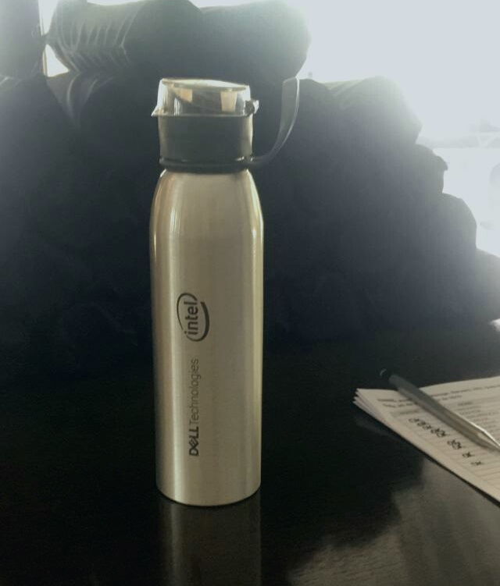

Supporting Documentation
Squeeze em inox
Proof of Execution

Slide 4

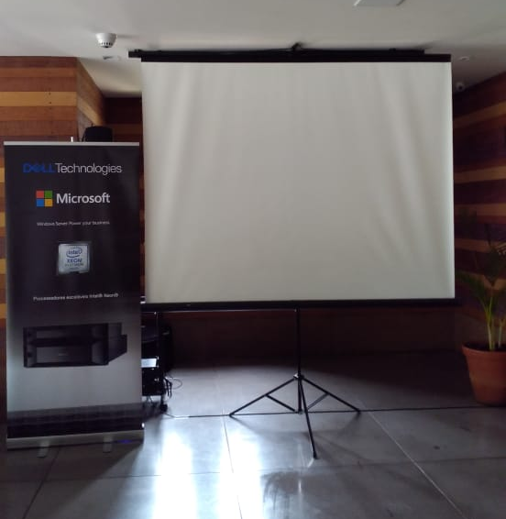
Supporting Documentation
Banner
Proof of Execution

Slide 5
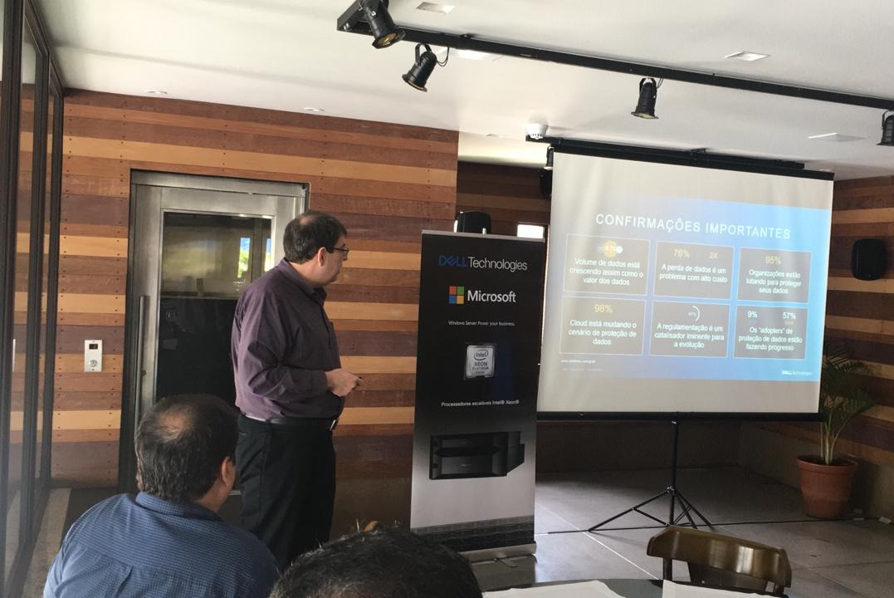
Supporting Documentation
Proof of Execution

Slide 6
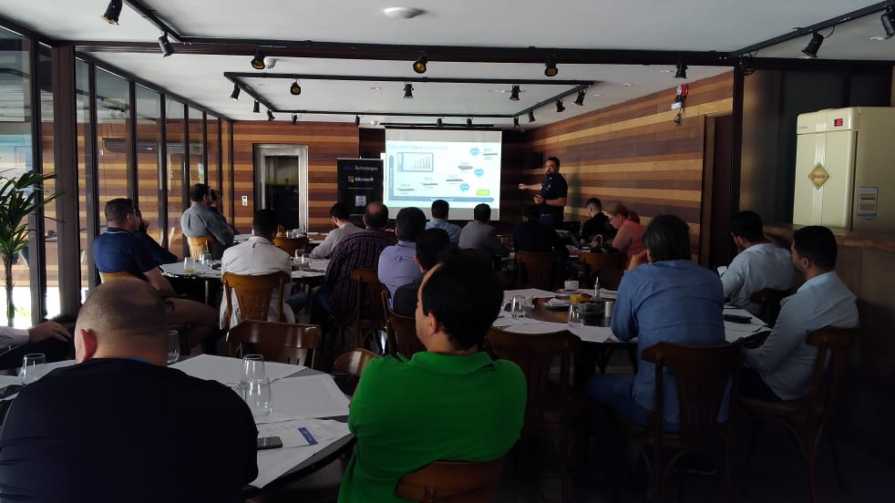
Supporting Documentation
Proof of Execution

Slide 7
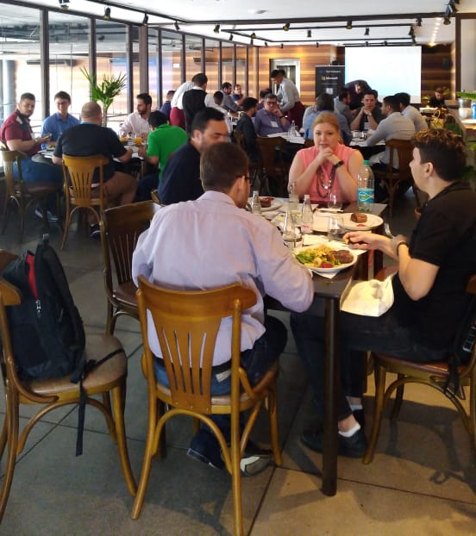
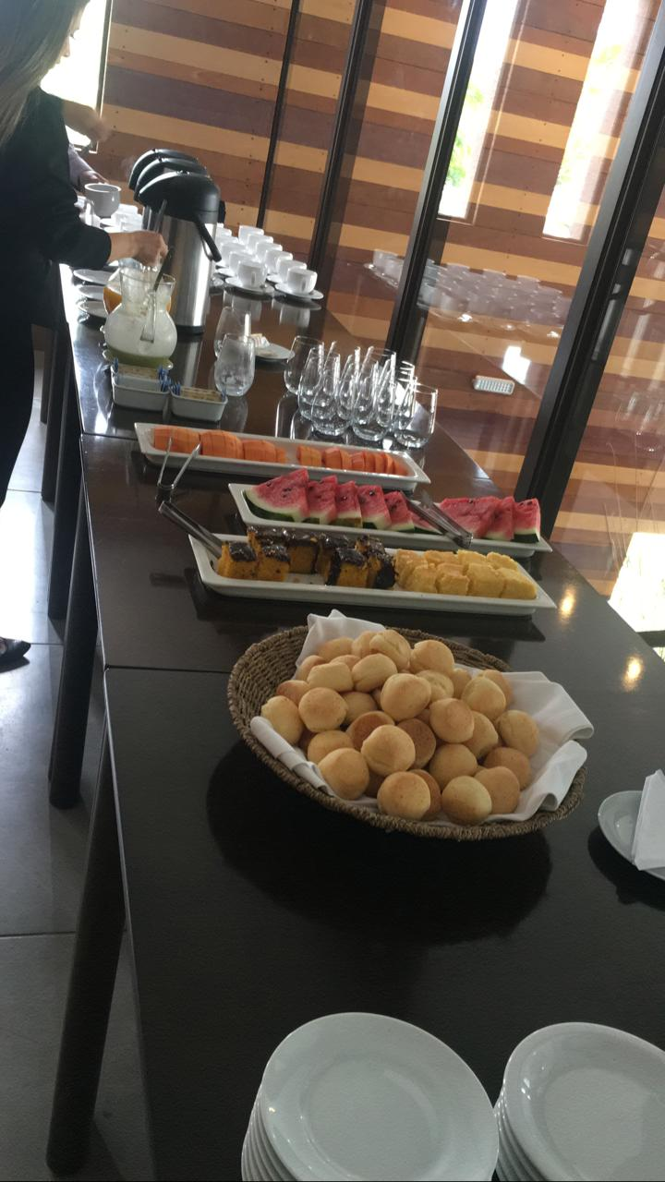
Supporting Documentation
Proof of Execution

Slide 8
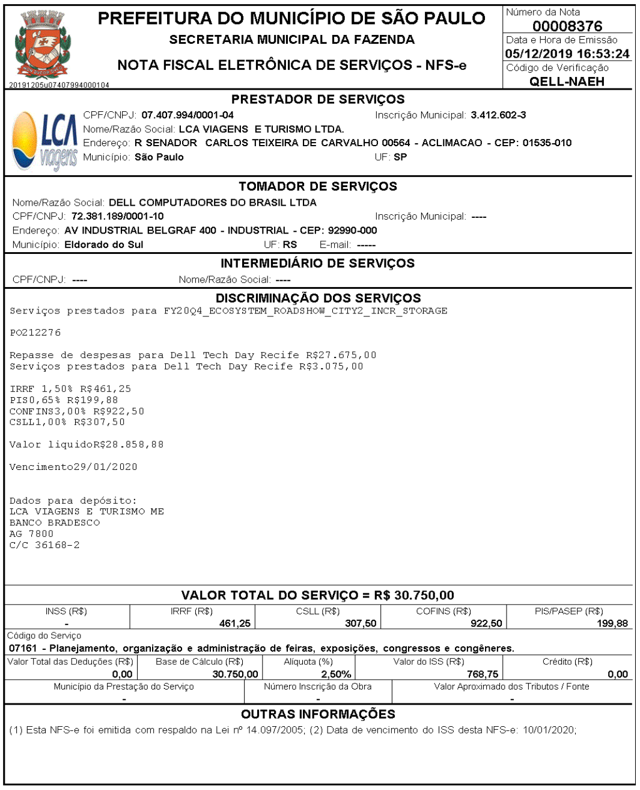
Supporting Documentation
Summary of Invoices & Vendors
Vendor | Invoice# | Gross Total Amount (local currency including taxes) | Invoice Currency (e.g. MXN, BRL, COP, USD) | Amount in USD (please convert as per Bloomberg exchange rate)
LCA Viagens | 8376 | R$ 30.750,00 | BRL | USD $ 7,500.00
Proof of Spend - Invoices

Slide 9
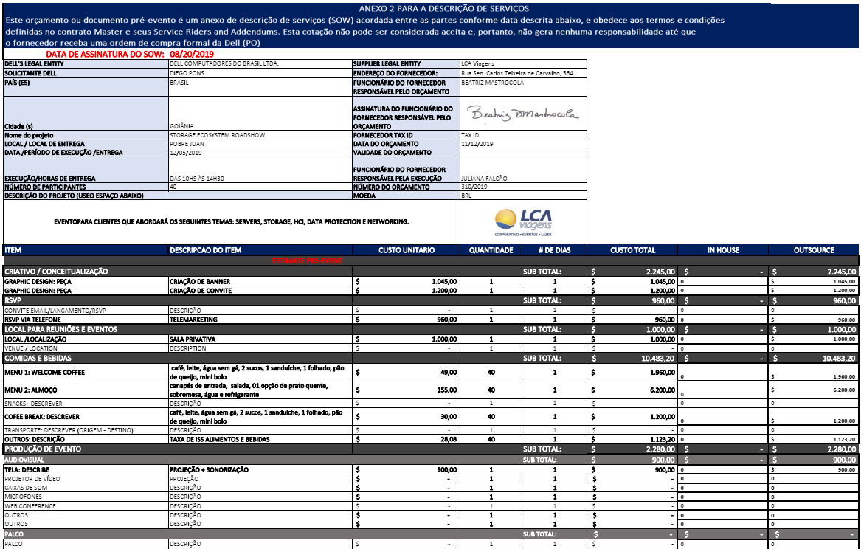
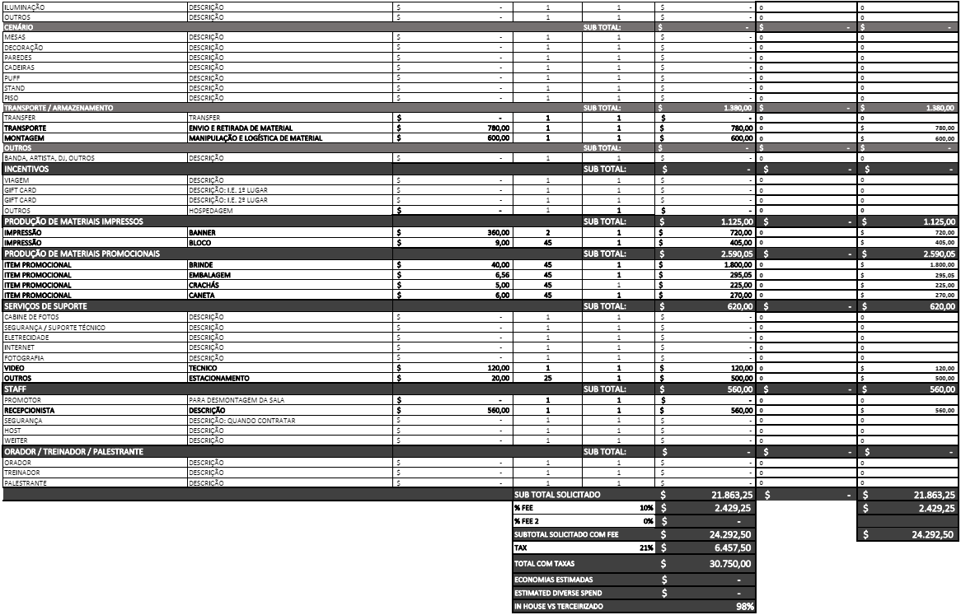
Supporting Documentation
Summary of Invoices & Vendors
Proof of Spend - Invoices

